Slide 1

What The CAF Module 04: ALZ Accelerator Azure Landing Zone Design Principles, Considerations, and Recommendations
Last updated: Sep 2022

Slide 2
Microsoft Cloud Adoption Framework for Azure
Define strategy
Understand motivations
Business outcomes
Business justification
Prioritize project
Plan
Digital estate
Initial organization alignment
Skills readiness plan
Cloud adoption plan
Ready
Azure setup guide
First landing zone
Expand the landing zone
Best practice validation
Ready
Azure setup guide
First landing zone
Expand the landing zone
Best practice validation
Adopt
Migrate First workload migration Expanded scenarios Best practice validation Process improvements
Innovate Innovation guide Expanded scenarios Best practice validation Process improvements
Govern
Methodology
Benchmark initial best practice
Governance maturity
Manage
Business commitments
Operations baseline
Operations maturity
https://aka.ms/adopt/overview
Notes:
The Microsoft Cloud Adoption Framework aligns different phases of the cloud adoption lifecycle to ensure easy access to the right guidance at the right time.
Ready: follows the strategy and planning works. It focusses on preparing cloud environment for the planned changes.
This is a key stage of the journey, as it represents the first technical implementation stage of the adoption.
A strong starting point is crucial for a great outcome, so the core elements of the Ready methodology are key success factors.
Ready is also a jump-off point for several of the other methodologies, which rely on the strong start as fuel for their own success:
Migrate: Migrate and modernize existing workloads on the cloud.
Innovate: Develop new cloud-native or hybrid solutions.
Govern: Govern the environment and workloads to ensure industry standards and regulatory requirements.
Manage: Conduct operations management for cloud and hybrid solutions.
Let’s begin looking at what Azure landing zones are.

Slide 3
Azure Landing Zones

Slide 4

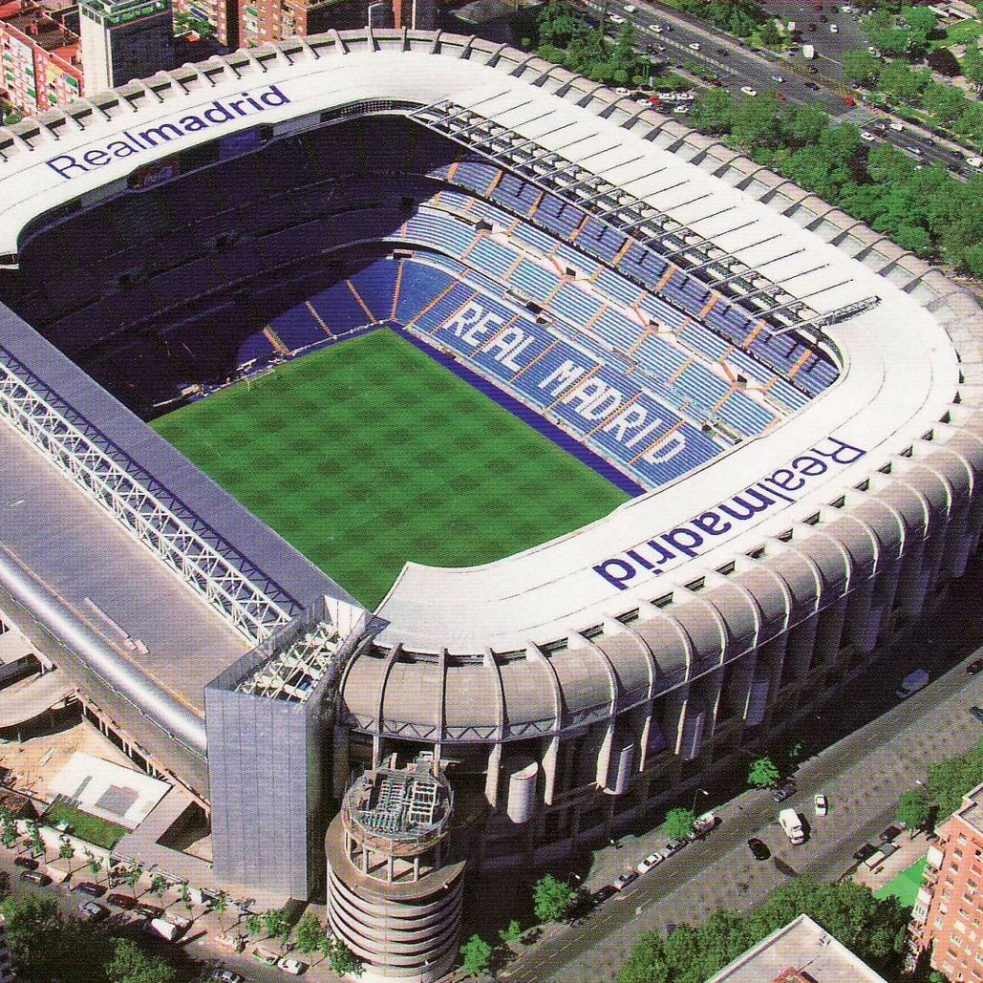

What are you building? Your cloud foundation supports the construction of a—
House
Stadium
Bridge

Slide 5
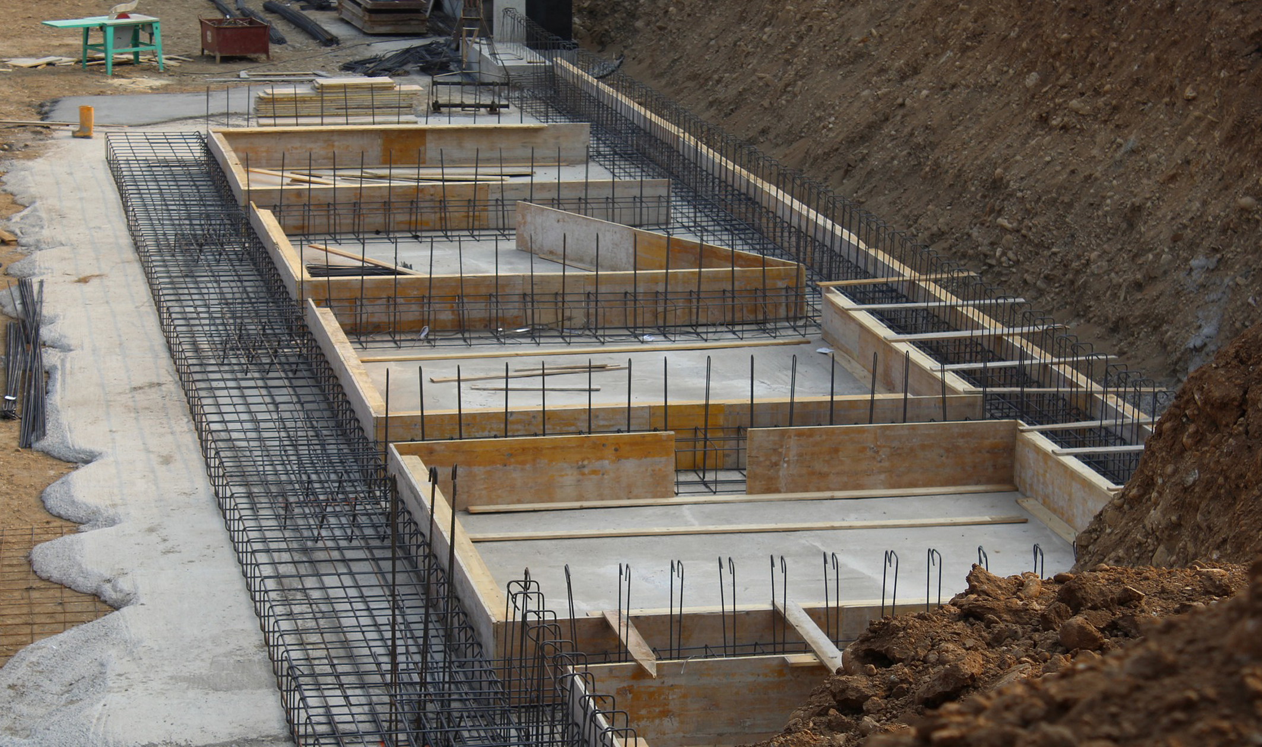
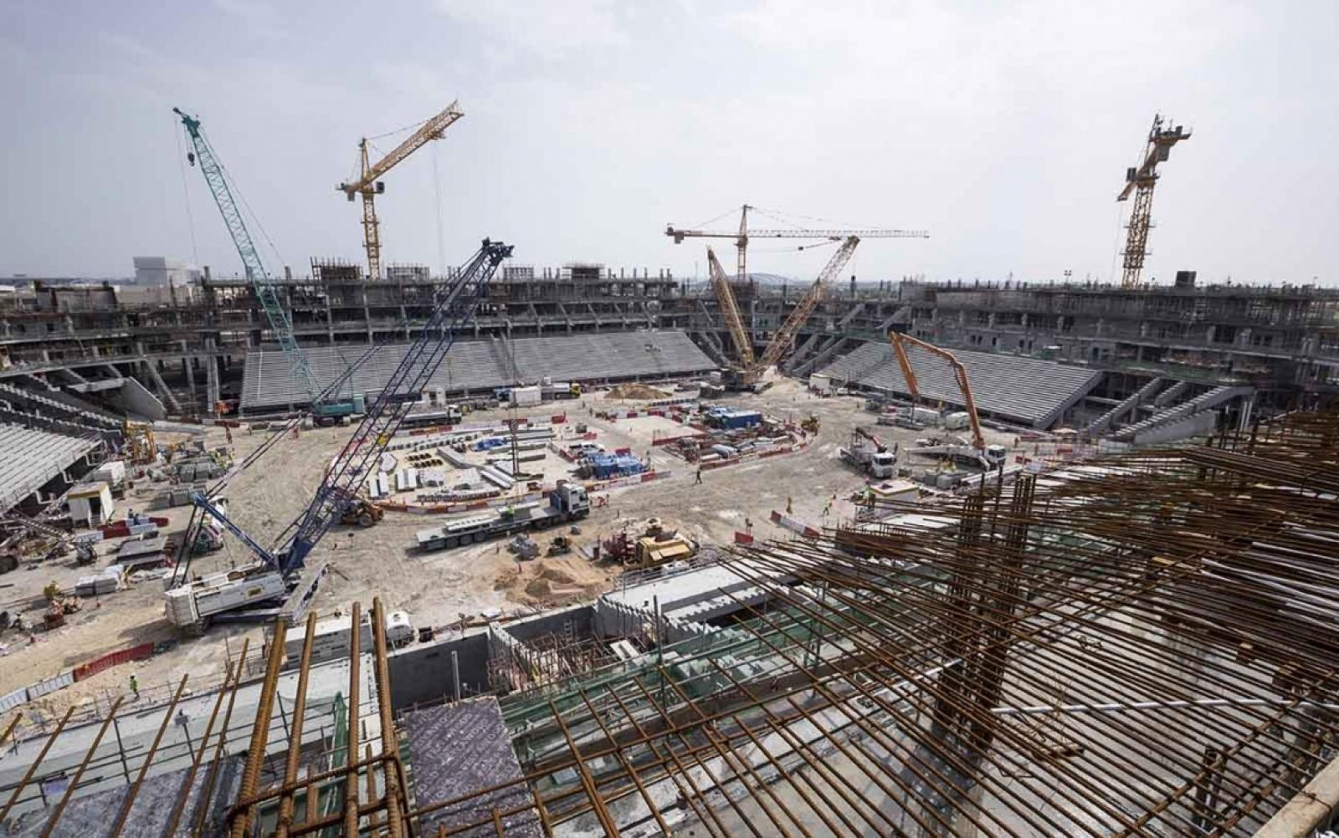
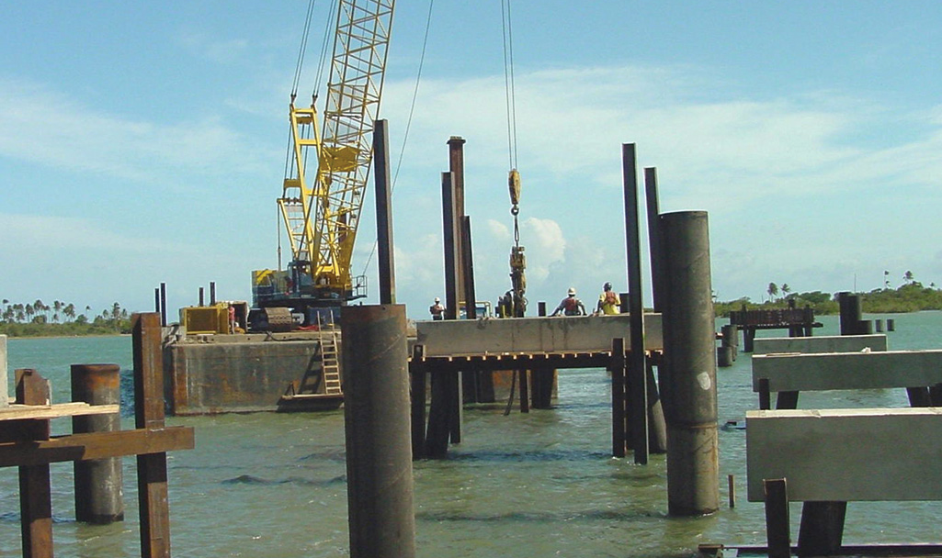
All foundations are NOT created equal
A house
A stadium
A bridge

Slide 6
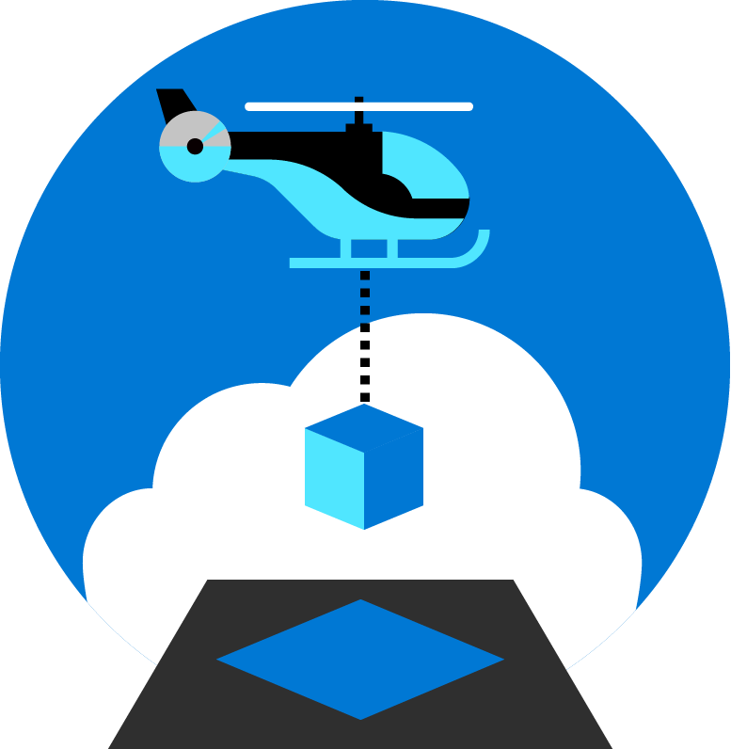
Azure landing zones
Set up Azure environments— for scale, security, governance, networking, and identity
Enable migrations and net new apps
Consider all platform resources
Don't differentiate between IaaS or PaaS
Notes:
Azure landing zones focus on unifying technologies and technical guidance to help you build a successful cloud environment.
In general, Azure landing zones:
Offer repeatable packaged environments
Enable migrations and net new apps.
Simplify the process of starting a cloud environment, to enable teams to focus on migration or innovation
Now, lets look in detail at what we consider to be the focus areas for a landing zone.

Slide 7





Azure landing zone Design Principles
Subscription Democratisation
Enable Autonomy for Innovation and Transformation
Security and Compliance By-Default
Governance At-Scale with Sustainable Cloud Engineering
Policy Driven Governance
Single Control and Management Plane
Application Centric and Archetype-Neutral
Azure Native Design and Platform Roadmap Alignment
Notes:
Just like organizing books in library (think of a book being a resource on a shelf in a cabinet in a room in the library) comes with set of principals (labelling, category). ALZ comes with set of design principals, which are necessary for organizing resources in subscriptions. These are (read out the 5 principles)
I’ll cover these principles in more detail in the following slides.
Subscriptions should be used as a unit of management and scale aligned with business needs and priorities. You should avoid to maintain central control for subscription creation, and allow business units to create subscriptions themselves. Your governance model should ensure that as subscriptions are created and moved to different management groups, policies are applied to enforce any necessary guardrails.
Azure Policy should be used to provide the “guard-rails” and ensure the continued compliance of the customer platform and applications deployed onto it, whilst also providing application owners sufficient freedom and a secure unhindered path to cloud.
The ALZ architecture should NOT rely on abstraction layers such as customer developed portals or tooling, and should provide a consistent experience for both AppOps (centrally managed operation teams) and DevOps (dedicated application operation teams).
The ALZ architecture should focus on application centric migrations and development rather than a pure infrastructure “lift and shift” migration (i.e. movement of virtual machines) and should not differentiate between old/new applications or IaaS/PaaS applications.
The ALZ architecture strongly advocates the use of native platform services and capabilities wherever possible, which should be fully aligned with Azure platform roadmaps from the offset to ensure new capabilities are swiftly made available within customer environments.
the use of native platform services and capabilities wherever possible, which should be fully aligned with Azure platform roadmaps from the offset to ensure new capabilities are swiftly made available within customer environments.

Slide 8

Azure landing zones Design areas
Azure billing & Azure Active Directory tenant
Security
Identity & access management
Governance
ENVIRONMENT
COMPLIANCE
Resource organization
Management
Network topology & connectivity
Platform automation & DevOps

Slide 9
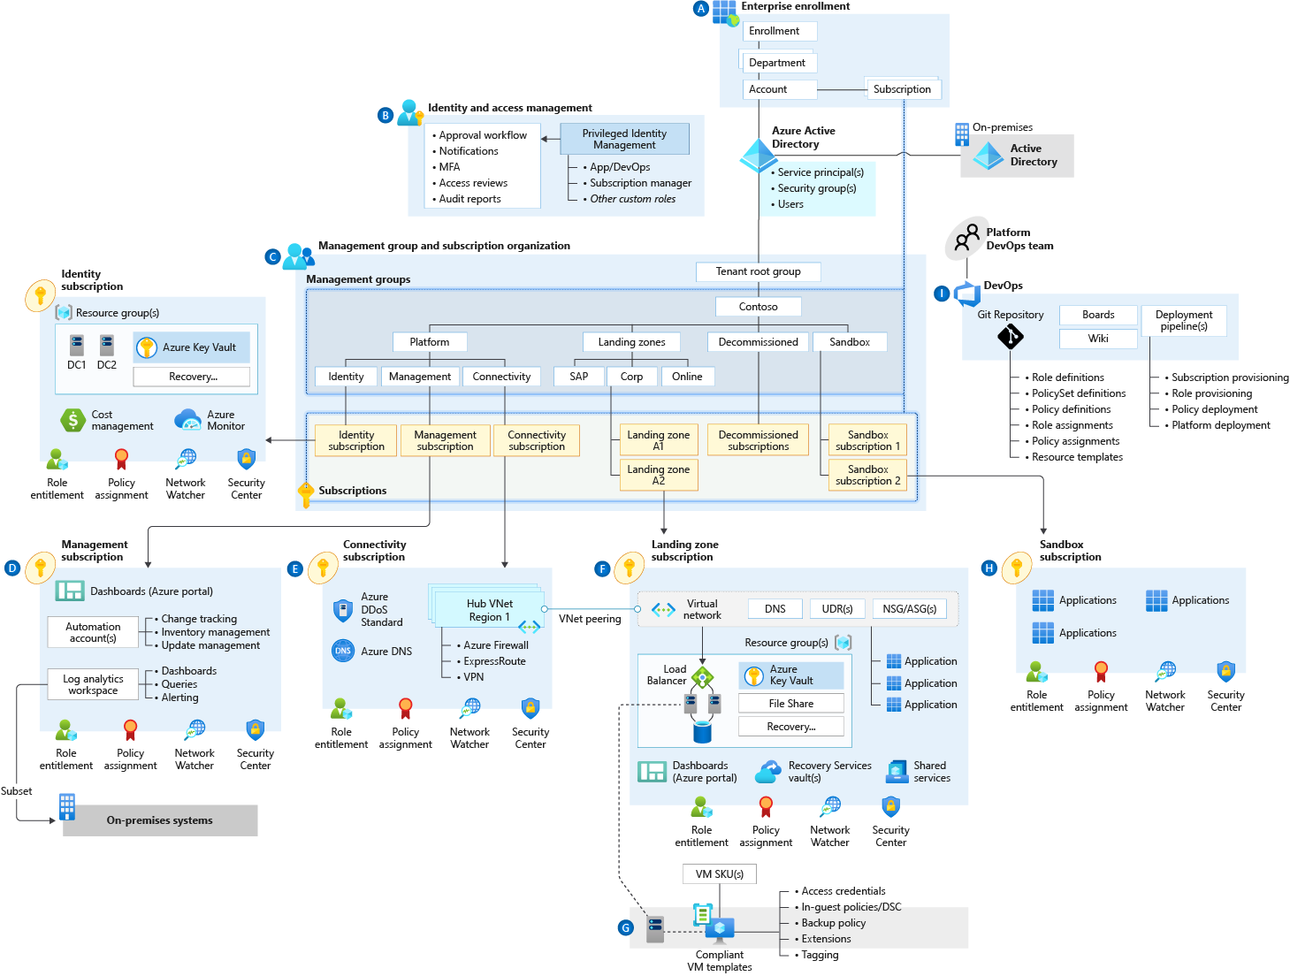
Azure landing zone conceptual architecture What does it represent?
Target end-state for most organizations
Scaled-out and mature environment
Customer and partner practices for environment design across Microsoft
Strong foundation for management, governance, and security processes
Notes:
Azure landing zone conceptual architecture
The destination (or target end-state) of the journey.
Scaled-out controls and architecture to enable customers to grow and innovate safely
Depending on the cloud operating model chosen, you may arrive at this destination quickly, or over time.
This may represent a subset of your estate, if you scale into enterprise operations or distributed operations
We are learning from engagements with customers and partners, codifying best practices guidance for the cloud adoption journey.
Let's dive into common starting points, and the typical phases of a cloud journey.

Slide 10
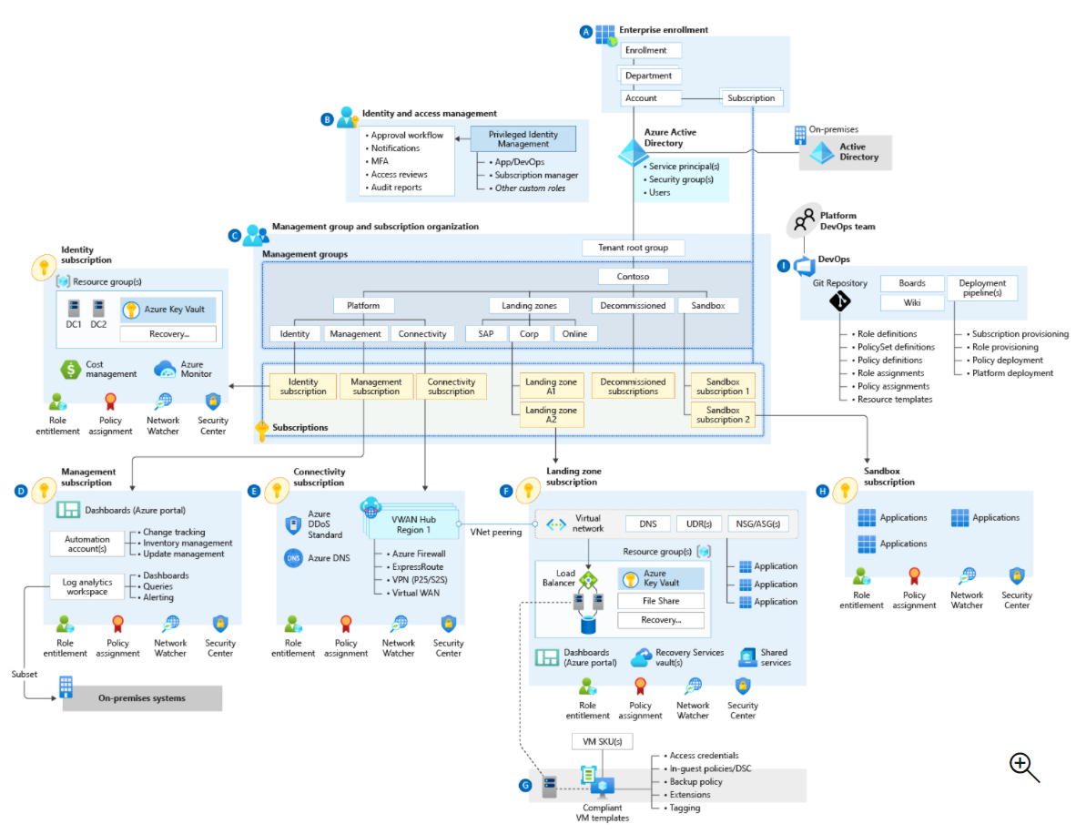
Common implementation approach
Target end-state:
Azure landing zones conceptual architecture
Check all boxes
Azure billing and AD tenant
Identity and access management
Network topology and connectivity
Resource organization
Governance
Management
Security
Platform automation and DevOps
Check few boxes
Check all boxes
Iterate and check
Small implementation
Notes:
Customers may take slightly different routes, but the end-goal should be the same.
With the target end-state in mind, we recommend a common, unified approach to landing zone implementation.
Progressing to the target end-state [Azure landing zones conceptual architecture]
All the onramps lead to the same freeway (ALZ conceptual architecture)
Your chosen design areas will affect your end-result, whether Start (greenfield development), Align (brownfield development involving refactoring), or Enhance (adding new controls or features to your environment).
Sometimes, organizations start down their own path – with a smaller subset of the design areas – and then look to bring their environment in closer alignment to the conceptual architecture.
This alignment drives towards the same outcome as if they’d taken one of the implementation options – and we’ll cover ALIGN a little later.

Slide 11
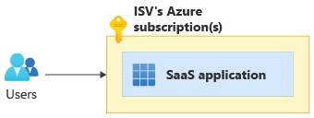
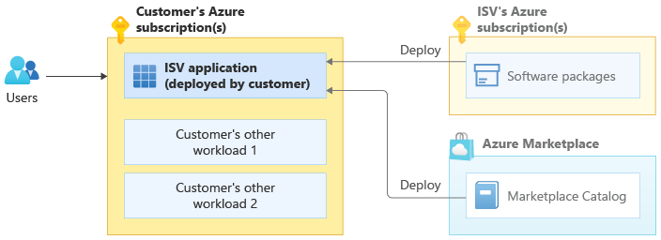
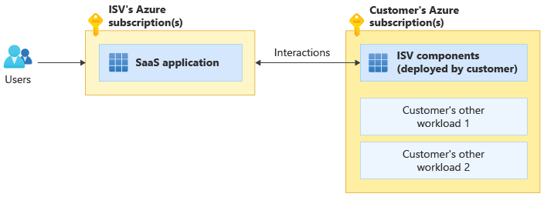
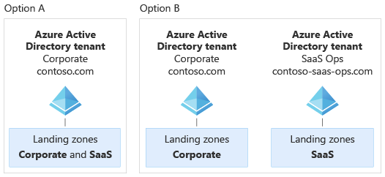
Independent software vendor (ISV) considerations for Azure landing zones
https://aka.ms/alz/isv
ISV deployment models:
Pure SaaS
Customer-deployed
Dual deployment SaaS
Azure Active Directory:
Notes:
The Azure landing zones help you choose a direction for your overall Azure environment. But as an ISV, SaaS provider, or startup, your specific implementation needs might differ from more standard customer scenarios. The following are just a few different implementation scenario examples:
You build software that customers deploy into their own subscriptions.
You have your own control plane and use automation scripts or software to deploy and configure Azure resources for your SaaS solutions.
You're a small ISV or startup and want to start with the lowest possible cost, and might not want to initially use services like Azure Firewall and Azure DDoS Protection.
You're a large SaaS ISV and plan to split your SaaS application across multiple subscriptions for scale. You also want to group the subscriptions so they correspond to your development, test, staging, and production environments.
Your organization's operating model separates the roles of your corporate IT team and your SaaS product teams. Your organization's corporate IT team might manage resources like Microsoft Office 365 and Microsoft Teams, and your SaaS product team might be responsible for building and operating your SaaS product (including its central platform and identity components).

Slide 12
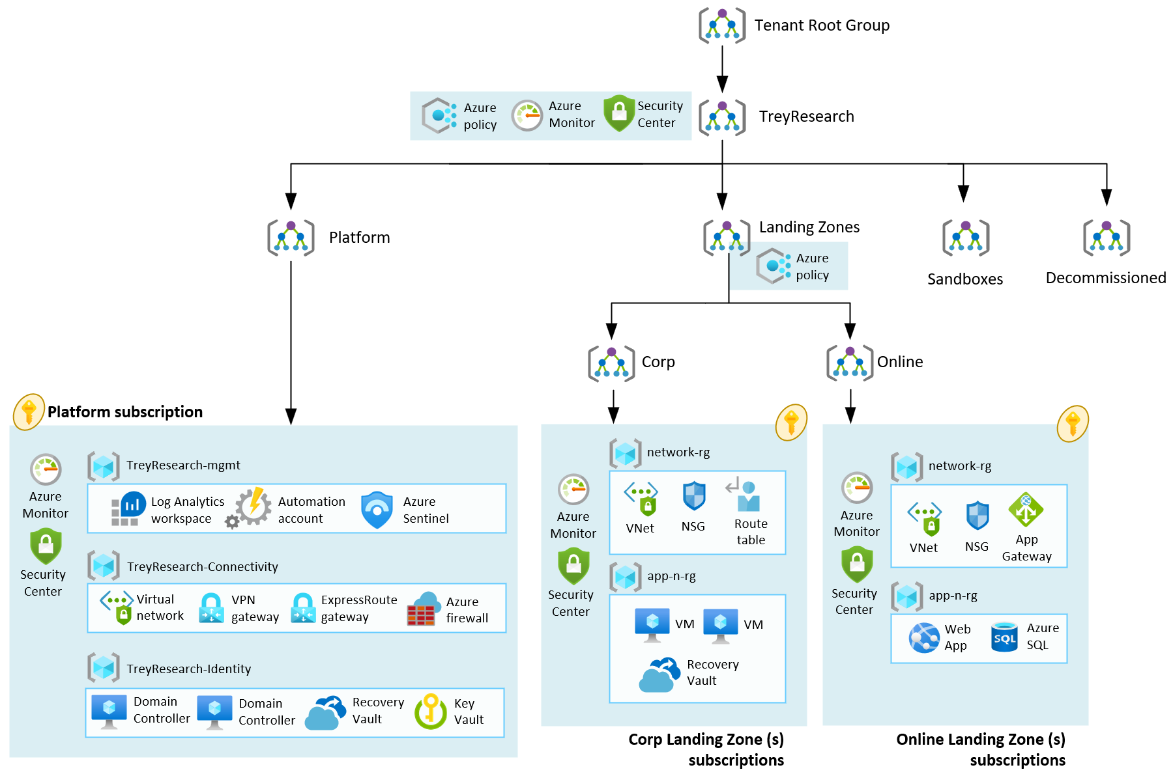
Managed Service Providers (MSP) considerations for Azure landing zones
Azure landing zone Trey Research Reference Implementation
Notes:
In Azure Active Directory (Azure AD), part of Microsoft Entra, each Azure AD organization is fully independent: a peer that is logically independent from the other Azure AD organizations that you manage. This independence between organizations includes resource independence, administrative independence, and synchronization independence. There is no parent-child relationship between organizations.
If you create or delete an Azure AD resource in one organization, it has no impact on any resource in another organization, with the partial exception of external users.
If you register one of your domain names with one organization, it can't be used by any other organization.
Administrative independence
If a non-administrative user of organization 'Contoso' creates a test organization 'Test,' then:
By default, the user who creates a organization is added as an external user in that new organization, and assigned the global administrator role in that organization.
The administrators of organization 'Contoso' have no direct administrative privileges to organization 'Test,' unless an administrator of 'Test' specifically grants them these privileges. However, administrators of 'Contoso' can control access to organization 'Test' if they sign in to the user account that created 'Test.'
If you add or remove an Azure AD role for a user in one organization, the change does not affect the roles that the user is assigned in any other Azure AD organization.

Slide 13
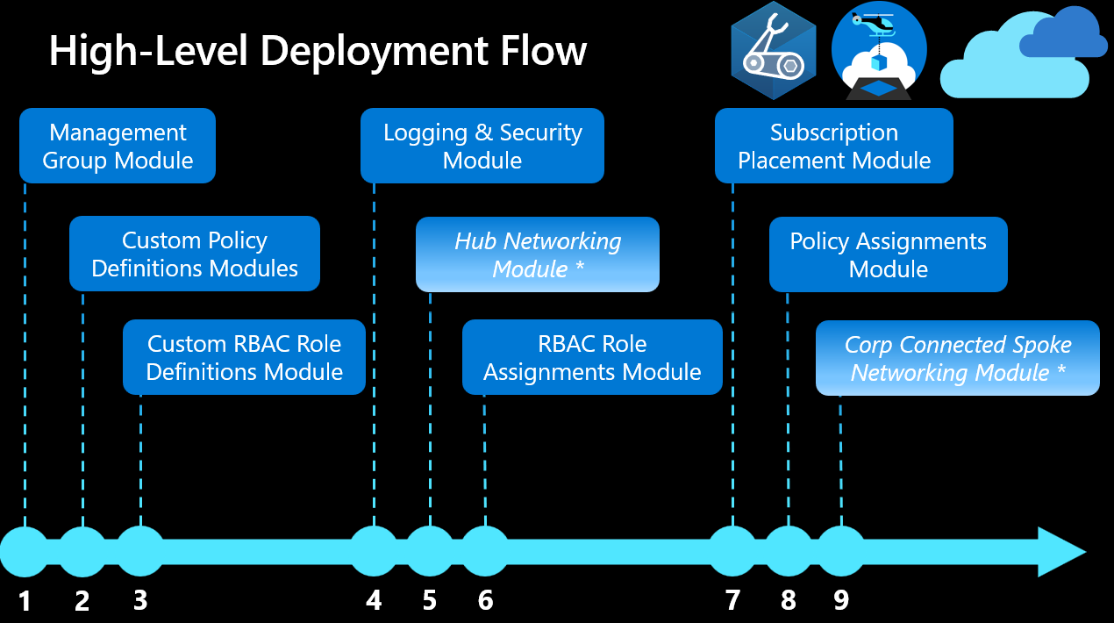
Managed Service Providers (MSP) considerations for Azure landing zones
https://aka.ms/alz/bicep
Azure landing zone Bicep Reference Implementation
Order | Module | Description
1 | Management Groups | Configures the management group hierarchy to support Azure Landing Zone reference implementation.
2 | Custom Policy Definitions | Configures Custom Policy Definitions at the organization management group.
3 | Custom Role Definitions | Configures custom roles based on Cloud Adoption Framework's recommendations at the organization management group.
4 | Logging & Sentinel | Configures a centrally managed Log Analytics Workspace, Automation Account and Sentinel in the Logging subscription.
5 | Hub Networking | Azure supports two types of hub-and-spoke design, VNet hub and Virtual WAN hub. Creates resources in the Connectivity subscription.
6 | Role Assignments | Creates role assignments using built-in and custom role definitions.
7 | Subscription Placement | Moves one or more subscriptions (based on IDs) to the target Management Groups in your ALZ hierarchy.
8 | Built-In and Custom Policy Assignments | Creates policy assignments to provide governance at scale.
9 | Spoke Networking | Creates Spoke networking infrastructure for workloads with Virtual Network Peering (optional) to support Hub & Spoke network topology or Virtual Hub Connection (optional).
Notes:
In Azure Active Directory (Azure AD), part of Microsoft Entra, each Azure AD organization is fully independent: a peer that is logically independent from the other Azure AD organizations that you manage. This independence between organizations includes resource independence, administrative independence, and synchronization independence. There is no parent-child relationship between organizations.
If you create or delete an Azure AD resource in one organization, it has no impact on any resource in another organization, with the partial exception of external users.
If you register one of your domain names with one organization, it can't be used by any other organization.
Administrative independence
If a non-administrative user of organization 'Contoso' creates a test organization 'Test,' then:
By default, the user who creates a organization is added as an external user in that new organization, and assigned the global administrator role in that organization.
The administrators of organization 'Contoso' have no direct administrative privileges to organization 'Test,' unless an administrator of 'Test' specifically grants them these privileges. However, administrators of 'Contoso' can control access to organization 'Test' if they sign in to the user account that created 'Test.'
If you add or remove an Azure AD role for a user in one organization, the change does not affect the roles that the user is assigned in any other Azure AD organization.

Slide 14
Design Considerations & Recommendations

Slide 15
Azure landing zones Design areas
Azure billing & Azure Active Directory tenant
Security
Identity & access management
Governance
ENVIRONMENT
COMPLIANCE
Resource organization
Management
Network topology & connectivity
Platform automation & DevOps

Slide 16
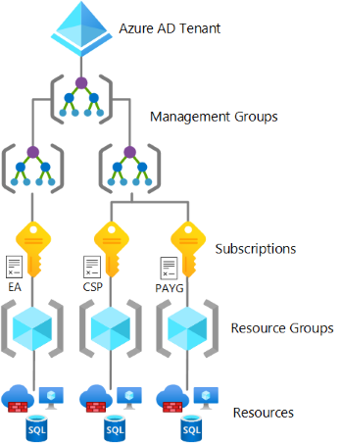

This critical design area focuses on the two highest levels of alignment across all of your Azure deployments; your Azure billing offer and the association of that offer with an Azure Active Directory (Azure AD) tenant.
Azure billing &
AAD Tenant

Slide 17
Billing & AAD Design Area Considerations and Recommendations
Ask basic security questions during the Azure AD design phase such as how the customer manages credentials and how they controls human, application, and programmatic access.
Remember that an Azure subscription can only trust one and only one Azure AD tenant at a time.
If there’s no identity infrastructure, start by implementing an Azure AD only identity deployment. But don’t forget to define your Azure SSO strategy!
Add at least one custom domain and define a single-sign on strategy using AAD Connect.
Enforce MFA via CAP for all privileged accounts ASAP. No MFA = “pleasebreachme”! And don’t forget to create a break-glass account.
Use Azure Lighthouse to grant 3rd parties and / or Microsoft partners access to Azure. But note that Azure Lighthouse only supports delegation at the subscription and resource group scopes.
Avoid creating multiple Azure AD tenants. Even if you are an ISV. Unless you have a rock-solid reason.

Slide 18
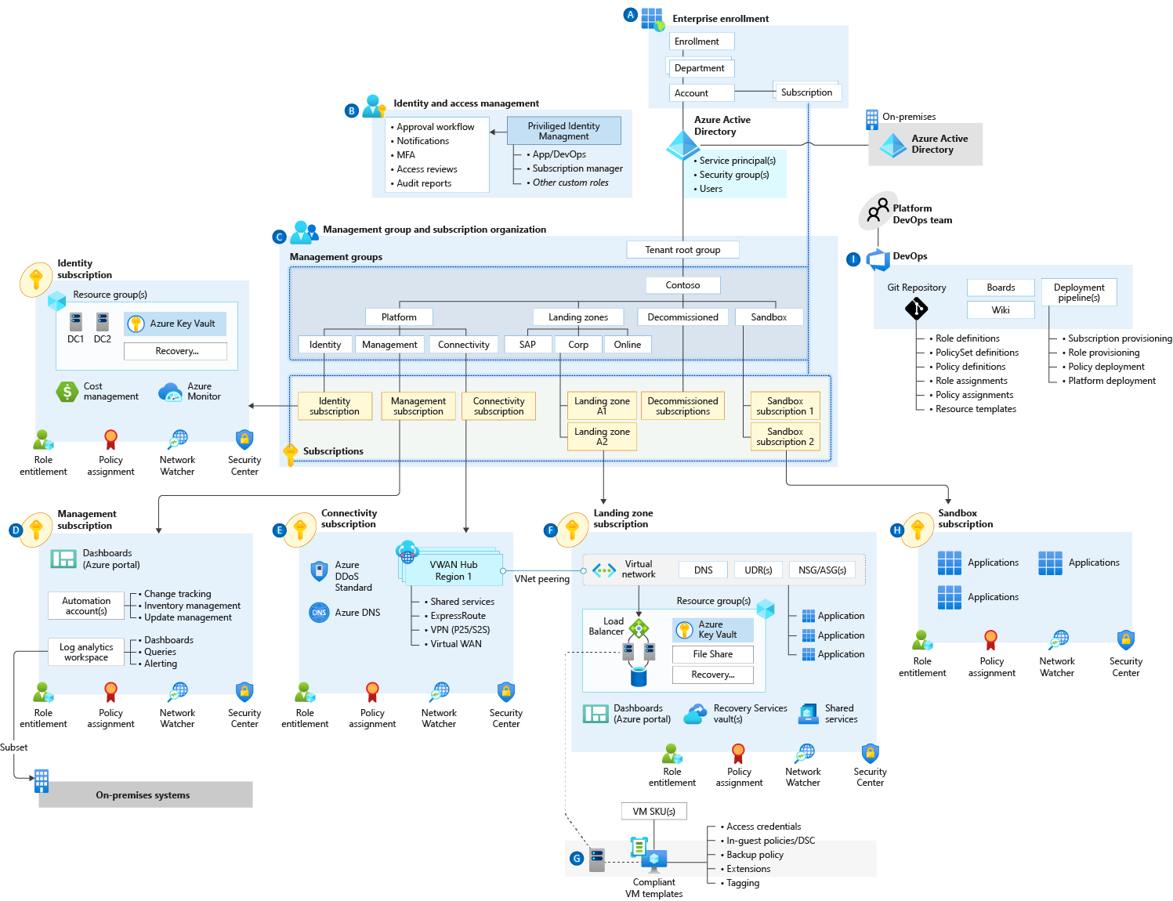

Identity & Access Management
This critical design area establishes a foundation for the management of identity and access.

Slide 19

Azure AD and Azure Roles
(Don’t confuse the two of them)
AAD Roles
Azure IAM Roles
Manage access to Azure AD resources
Can be scoped to Tenant, Administrative Unit, or Object (application)
Accessible in the Azure Portal and M365 Admin Portal
AAD Global Admin can self-assign permissions to manage Azure resources
Manage access to Azure resources
Can be scoped to Management Group, Subscription, Resource Group, or Resource
Accessible in the Azure Portal

Slide 20
Identity and Access Management Design Area
Considerations and Recommendations
Consider centralized and delegated responsibilities to manage resources deployed inside the landing zone.
Which services or applications within your landing zone support Azure Active Directory authentication?
Does the organization need to extend a current on-premises Active Directory domain into Azure?
Are there applications that are partly hosted on-premises and partly hosted in Azure?
Use AAD-only groups to assign access to Azure resources & start with built-in Azure role definitions, and add on-premises groups to AAD-only groups where applicable.
Deploy MFA + CAP for users with access to Azure & use PIM to establish zero standing access.
Use managed identities instead of service principals for authentication to Azure services. And (where supported) instead of service principals, use workload identity federation in scenarios such as GitHub Actions and workloads running on Kubernetes.

Slide 21

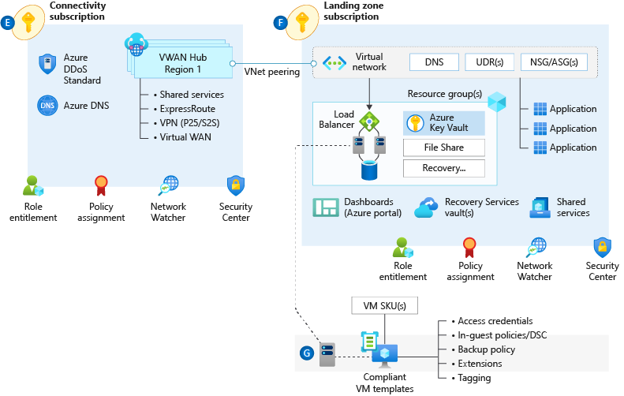
Network Topology & Connectivity
The network topology and connectivity design area is critical for establishing a foundation for your cloud network design.

Slide 22
Network Topology & Connectivity Design Area Considerations & Recommendations
Define a topology. There’s only 2 – Hub & Spoke and Virtual WAN.
Plan IP Addressing. Don’t use /16 unless really needed. Use at least /24 for Hub. Avoid overlapping IP address, including BCDR scenarios. Azure reserves 5 IP addresses from every subnet. Some Azure services require dedicated subnets. These dedicated subnets might have restrictions around naming, sizing, NSGs, and UDRs.
When you use multiple ExpressRoute circuits, optimize ExpressRoute routing via BGP local preference and AS PATH prepending. Deploy a zone-redundant ExpressRoute gateway in the supported Azure regions.
Monitor your network. Use ExpressRoute Insights, Network Watcher, and Connection Monitor.
Use virtual network injection for supported Azure services to make them available from within your virtual network. Azure PaaS services that have been injected into a virtual network still perform management plane operations by using public IP addresses. Ensure that this communication is locked down within the virtual network by using UDRs and NSGs.

Slide 23
Network Topology & Connectivity Design Area Considerations & Recommendations
Use Private Link, where available, for Azure PaaS services.
Use virtual network service endpoints to secure access to Azure PaaS services from within your virtual network, but only when Private Link isn't available and there are no data exfiltration concerns. Unless you use NVA filtering.
Perform application delivery within landing zones for both internal-facing and external-facing applications. For secure delivery of HTTP/S applications, use Application Gateway v2 and ensure that WAF protection and policies are enabled in prevention and not detection mode. Use a partner NVA if you can't use Application Gateway v2 for the security of HTTP/S applications.
When you're using Front Door and Application Gateway to help protect HTTP/S applications, use WAF policies in Front Door. Lock down Application Gateway to receive traffic only from Front Door.
Plan for inbound and outbound internet connectivity. Use Azure Firewall to govern outbound internet traffic, east <-> west, and on-premises <-> Azure traffic.

Slide 24
Resource Organization
The critical resource organization design area establishes consistent patterns for organizing resources deployed to the cloud.

Slide 25
Resource Organization Design Area Considerations and Recommendations
Avoid replicating the organization’s hierarchy chart. What if the customer goes thru a re-org?
Avoid organizing for billing purposes. The industry standard is to use Tags (accounting) + Azure Cost Management to query & aggregate costs. Make this available to application owners.
Keep the management group hierarchy flat (3-4 levels).
Focus on organizing based upon Azure Policy Assignments (e.g., restrict public IP on internal workloads, prod/non-prod naming conventions, etc.).
Utilize a sandbox management group & configure a default management group for new subscriptions.
Limit Policy assignments made at the intermediate management group.
Create management groups to represent regulatory workloads (GDPR, PCI, region-locked, etc.).
Consider limits and quotas within the Azure platform for each service that your workloads require. Raise support requests for quota increases under subscription provisioning, such as for total available VM cores within a subscription. Ensure that quota limits are set before workloads exceed the default limits.

Slide 26
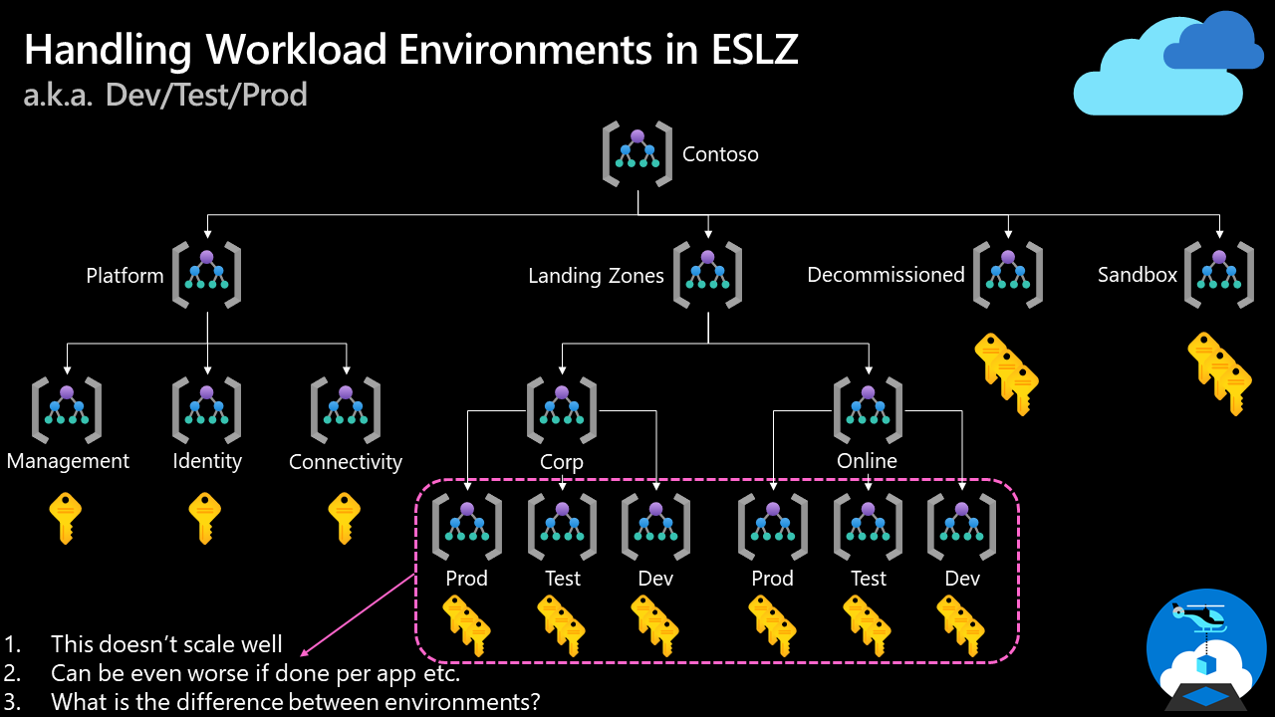
How do we handle "dev/test/production" workload landing zones in enterprise-scale architecture?

Slide 27
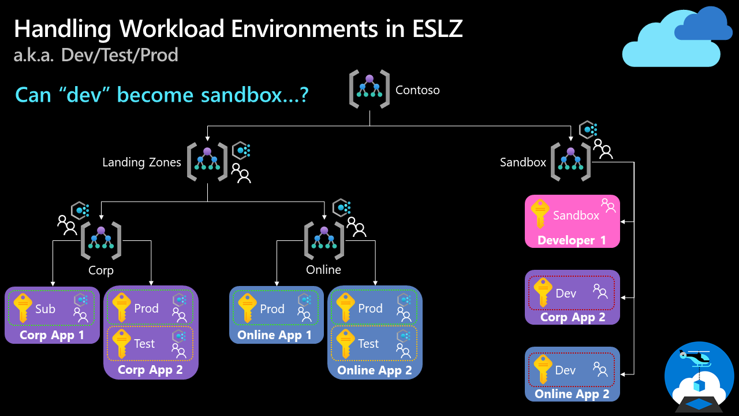
How do we handle "dev/test/production" workload landing zones in enterprise-scale architecture?
Note: We discussed this topic in our enterprise-scale community call in August 2021. You can find the recording on YouTube.

Slide 28

Security
This design area creates a foundation for security across your Azure, hybrid, and multicloud environments.
You can enhance this foundation later with security guidance outlined in the Cloud Adoption Framework's Secure methodology.

Slide 29
Security Design Area Considerations and Recommendations
Which teams require notifications for security alerts?
What about emergency patching for critical vulnerabilities?
Who requires access to encryption keys in the environment? And who will be responsible for managing the keys?
Develop and follow a roadmap to secure privileged access against cyber attackers.
Use AAD PIM, identify & categorize accounts in highly privileged roles, define at least two break-glass accounts, enforce MFA with CAP.
Enable Defender for Cloud to protect your environment and your workloads.
Use Security Posture to monitor your overall security posture. Use the Secure Score Over Time workbook.
Apply Zero-Trust and Defense-in-Depth principles. Apply and enforce network segmentation.
Use Azure Policies to audit and enforce governance around security, compliance and regulatory requirements.

Slide 30
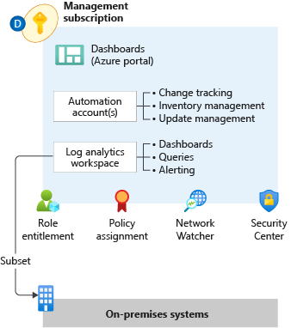

Management
This design area establishes a foundation for operations management across your Azure, hybrid, or multicloud environments.

Slide 31
Management Design Area
Considerations and Recommendations
Observability not Monitoring. Seek total visibility, a key monitoring principle, as soon as possible. Once initial observability is achieved, then build upon that initial level of visibility to develop actionable alerts (don’t spam!), create useful dashboards, and evaluate AIOps solutions.
The ALZ Accelerator includes diagnostic settings for activity logs, VMs, and PaaS resources sent to Log Analytics. Use a single monitor logs workspace to manage platforms centrally except where Azure RBAC, data sovereignty requirements, and data retention policies mandate separate workspaces. Data sent to a different region via Diagnostic settings doesn't incur data transfer charges.
Export logs to Azure Storage if log retention requirements exceed two years.
Don't send raw log entries back to on-premises monitoring systems. Instead, adopt a principle that data born in Azure stays in Azure.
Use Azure Monitor Metrics for time-sensitive analysis. Use Azure Monitor Logs for insights and reporting. Use Azure Monitor alerts for generating operational alerts.
Use Update Management in Azure as a long-term patching mechanism.

Slide 32
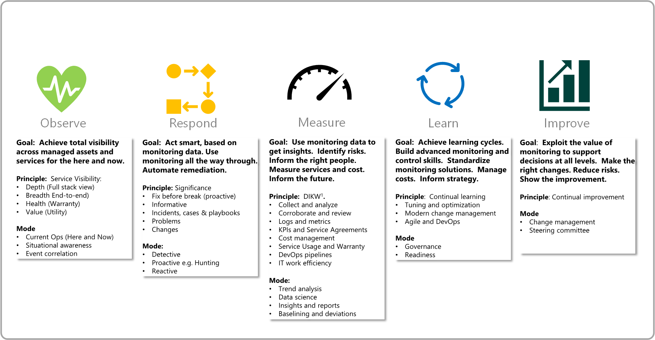
Management Design Area
The 5 Disciplines of Monitoring

Slide 33

Management Protect and Recover
Murphy’s law
"Anything that can go wrong will go wrong.“
Also, because sh!t happens.

Slide 34
Building reliable systems is a shared responsibility
Your application
Your app or workload architecture, built on the below.
Resiliency features
Optional Azure capabilities you enable as needed – high availability, disaster recovery, and backup.
Resilient foundation
Core Azure capabilities built into the platform – how the foundation is designed, operated, and monitored to ensure availability.

Slide 35
Resilience, HA, DR, and Reliability
Resilience
The ability to recover gracefully and continue functioning with minimal downtime
HA
The ability to stay available during outages
DR
The ability to continue operations when normal repair activities cannot recover in a reasonable timeframe
Reliability
Combined measure when an application or services is resilient, highly available, and has a defined approach to backup and DR

Slide 36
Resilience, HA, DR, and Reliability
RTO vs RPO
Recovery Point Objective (RPO)
Disaster Hits
Recovery Time Objective (RTO)
Time
Data Lost
Downtime

Slide 37
Resilience, HA, DR, and Reliability
Resilience vs Disaster Recovery
Resilience and Disaster Recovery (DR) are not the same.
Customers may have different goals for ongoing resilience than infrequent disaster responses.
Don’t assume one solution for both unless they have the same goal
DR frequently has geographic separation requirements which are difficult to deal with in live transactional systems due to imposed network latency.
For both resilience and DR, it doesn’t exist if it isn’t tested
Fault injection is a good approach for all reliability measures.
Assume DR must be tested on a live system.
Often regulatory requirements will mandate this so testability without incurring business impact should be a goal.

Slide 38
Business Continuity and Disaster Recovery
Considerations and Recommendations
Review the Reliability Pillar from Well Architected. If it’s not measurable, it’s not actionable. Define the RTO and RPO requirements for each workload; if you can’t then assign a default.
Eval and plan application operations with reduced functionality or degraded performance during an outage.
Eval workload suitability for Availability Zones or availability sets. Not all Avail. Zones are equal – always measure latency.
What about consistent backups for apps and data?
Prevent an “Ooops!” moment. Use resource locks to prevent accidental deletion of critical shared services. Prevention is better than cure.
Employ ASR for Azure-to-Azure VM DR scenarios.
Use native PaaS DR capabilities and Azure-native backup capabilities.
Use multiple regions and peering locations for ExpressRoute connectivity.
Avoid using overlapping IP address ranges for production and DR sites.

Slide 39

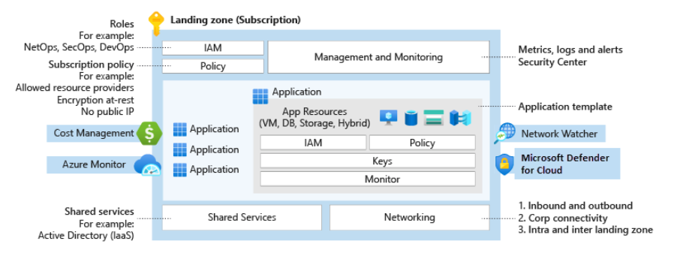
Governance
Azure governance establishes the tooling needed to support cloud governance, compliance auditing, and automated guardrails.
Governance provides mechanisms and processes for maintaining control over platforms, applications, and resources in Azure.

Slide 40
Governance
Going faster, whilst maintaining control and stability.
Change advisory review boards might hinder an organization’s innovation and business agility.
Azure Policy increases workload efficiency by replacing such reviews with automated guardrails and adherence audits.

Slide 41
Governance Design Area
Considerations
Determine what Azure policies are needed based on your business controls or compliance regulations. Use the policies included in the ALZ Accelerator as a stating point.
How is the organization’s cost and recharging model structured? What are the key data points required to accurately see cloud services spend? How will this be reflected in Tags?
Azure Cost Management + Billing might help support ongoing governance cost and spending in Azure, or other multicloud environments.
What are the groups of resources in the environment? These groups can share configuration characteristics that might be required to help stay consistent.
What tools and guardrails need to be enforced across the environment as part of a security baseline? And who might be notified when deviations are found?
Who might have access to audit logs for identity and access management? Who might be notified when suspicious sign-in events occur? Consider using AAD reports to govern activity.

Slide 42
Governance Design Area
Recommendations
Identify required Azure tags and use the modify policy mode to enforce usage. Use the tagging strategy article as a starting point.
Map regulatory and compliance requirements to Azure Policy definitions and Azure role assignments. Establish Azure Policy definitions at the intermediate root management group as they might be assigned at inherited scopes.
Use built-in policies to minimize operational overhead.
Use Azure Cost Management + Billing to implement financial oversight on resources in your environment. Use tags in Azure to append metadata to resources, which might enable granular analysis of spend (such as cost center, environment, project, owner, etc.).

Slide 43
Platform Automation & DevOps
Platform automation and DevOps evaluate opportunities to modernize your approach to environmental deployment with infrastructure as code options.

Slide 44
Platform Automation and DevOps Design Area
Considerations
Determine the DevOps practices your team should implement first based on their current skilling, and design a roadmap to incrementally apply new practices that help your team improve their DevOps metrics. Investing in engineering capabilities and resources is critical.
IaC-based accelerators have limited management scope. New versions provide more capabilities and increased resource management ability. If using an accelerator, your team should consider a layered approach that starts with an accelerator, then adds a layer of automation. The automation layer provides capabilities your team needs in order to fully support your workload teams with platform features like domain controller deployment for legacy applications.
You can use Azure Policies to add some automation to your platform. Consider using IaC to deploy and manage Azure Policies, often referred to as Policy-as-Code (PaC). These policies let you automate activities like log collection.
Use "Policy-driven-governance" to signal to workload teams when they're attempting to deploy resources that don't meet a security control. Consider deploying policies with the deny effect for these situations, which allows your workload teams to also treat Everything as Code and avoid configuration drift where code declares one thing and policy changed a setting at deployment time. Avoid using modify effects since this leads the code to drift from what is deployed.

Slide 45
Platform Automation and DevOps Design Area
Recommendations
Follow an Everything as Code approach for full transparency and configuration control of the Azure platform, documentation, deployment, and testing process. Work to automate everything, such as the provisioning, configuration, and management of your platform and the provisioning of landing zone subscriptions for your workload teams.
Use one of the available accelerators that matches your team's capabilities to get started with deploying Azure Landing Zones.
Use Infrastructure as Code to deploy and manage Azure Policies (often referred to as Policy-as-Code)
Implement an exemption process for policies. Plan for your workload teams to request exemptions from policies, and be ready to unblock the teams when needed.
Use "Policy-driven-governance" to block workload teams when they attempt to deploy resources that don't meet a security control. This helps reduce configuration drift, where code declares a different state than what ends up being deployed.

Slide 46
Resources & Next Steps

Slide 47
Azure Landing Zones Resources
Complete the MS Learning Path: Create an Enterprise-Scale Architecture on Azure
Review the Azure landing zone Architecture guidance
Explore the Azure landing zone Implementation options
Share your Feedback!
New Azure Landing Zones Survey
https://aka.ms/alz/survey
Issues on Github
https://aka.ms/enterprisescale https://aka.ms/alz/bicep
https://aka.ms/alz/tf

Slide 48
Thank you!

